Slide 1
Apologetics… Defending the Faith
Scripture in Support of Our Catholic Beliefs
Lesson 1 – The Ten Commandments & Idolatry

Slide 2
Why Apologetics?
Jesus teaches us…
“Go therefore and make disciples of all the nations, baptizing them in the name of the Father and the Son and the Holy Spirit”
Matthew 28:19
Notes:
We are instructed by Jesus himself to go and make disciples of all the nations.
It’s our job to evangelize our faith to ALL NATIONS… that means EVRYONE!

Slide 3
Why Apologetics?
Paul teaches us…
“…but sanctify Christ as Lord in your hearts. Always be ready to give an explanation to anyone who asks you for a reason for your hope,”
1 Peter 3:15
Notes:
Paul instructed to defend and explain our faith in the scriptures…
He writes in his first letter to Peter to always be ready to defend the faith…

Slide 4
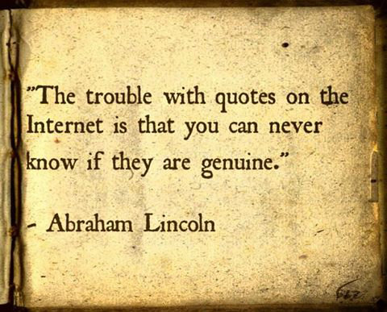
Why Apologetics?
Have you ever wondered what is true and what is not?
Notes:
I’m the guy who questions everything. I don’t believe it until I have researched it and am certain that whatever is said is truth or stupidity.

Slide 5
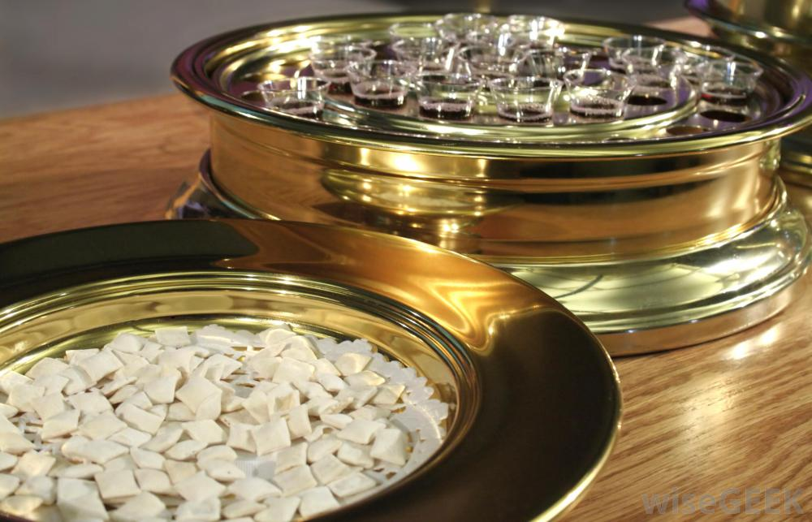
Why Apologetics?
Can you answer questions about your faith with confidence in the truth?
If Jesus loves everyone, why was I not welcome at His table?
Notes:
So I married a Cradle Catholic and I began asking questions bout the Catholic faith and found most of the answers to be reasonable but I was stuck hard on one question in particular.

Slide 6
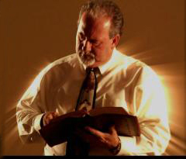
Why Apologetics?
Can you answer questions about your faith with confidence in the truth?
Michael Cumbie
Notes:
In 2009. Michael Cumbie came to St. Mary Magdalene and answered my last remaining roadblock to my conversion.
That only STARTED my quest for the truth. The result, (So far) has been my interest in apologetics.

Slide 7
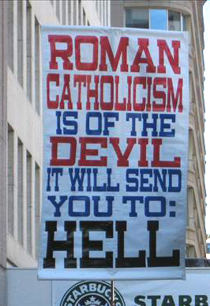
Why Apologetics?
Have you ever been confronted by someone about your Catholic faith?
Notes:
So how many times have you been confronted by someone who questioned your faith.
Here in the Bible Belt we are the minority in the Cristian faith. Most Protestants do not believe in the teachings of the Catholic Church and some of them actually believe that we are not scriptural and are headed straight to hell.

Slide 8
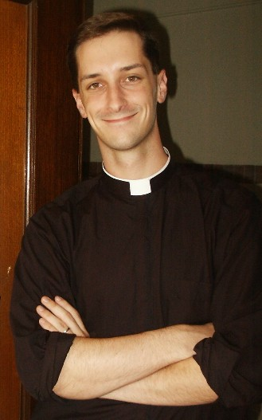
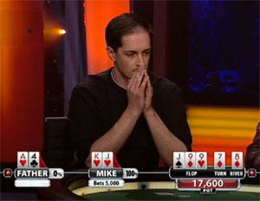
Why Apologetics?
Father Andrew Trapp, the Poker Playing Priest
Raised $100,000 for his parish building fund.
Notes:
Sometimes we are set on our paths in the strangest of ways…
Extremely popular with the youth of our diocese, Fr. Andrew Trap was a workshop presenter at the 2012 Diocesan Youth Conference for the Diocese of Charleston, held (ironically) at the Baptist White Oak Conference Center near Columbia, South Carolina.
He conducted a workshop on apologetics which I attended and he distributed this handout…

Slide 9
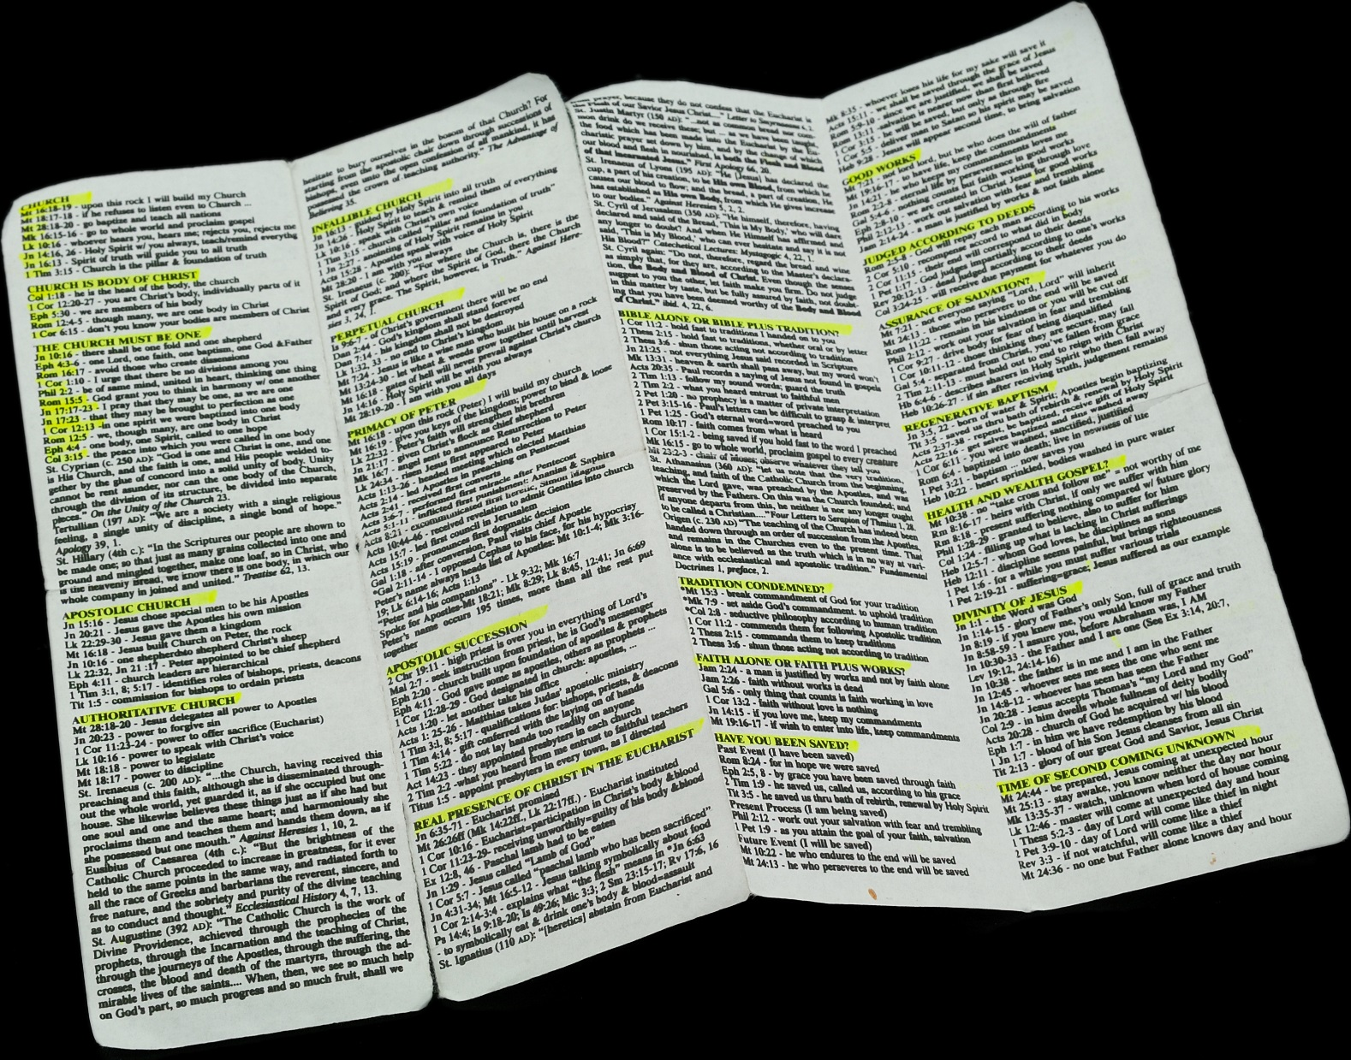
Why Apologetics?
Notes:
The original reference sheet from 2012 DYC given to me by Fr. Andrew Trapp, the Poker Playing Priest.
It was the template for the piece I handed out earlier to all of you.

Slide 10
Why Apologetics?
Remember that Paul teaches us…
To “Always be ready to give an explanation to anyone who asks you for a reason for your hope,”
1 Peter 3:15
Notes:
Paul instructed us to defend and explain our faith in the scriptures…
He writes in his first letter to Peter to always be ready to defend the faith…

Slide 11
Why Apologetics?
…but do it with gentleness and reverence, keeping your conscience clear, so that, when you are maligned, those who defame your good conduct in Christ may themselves be put to shame.
1 Peter 3:16
Notes:
But, always be gentle and loving in your discourse…
Always do it with gentleness and reverence. Never debate.
Question, understand then explain. Listen for the other point of view, then gently explain yours. Never let it come down to right or wrong, let it be about interpretation. This is how I see it, that is how you see it. Once you put the other person on the defensive, you have lost your advantage and they will likely become obstinate and closed minded.

Slide 12
What is Apologetics?
“There comes a time when we as Catholics, have to be able to defend and explain certain teachings of our catholic faith.
Our faith is based on reason and logic.
The explanation of what we believe and why we believe it is called apologetics.”
Bishop David Foley, Diocese of Birmingham.
Notes:
Bishop David Foley, of the Diocese of Birmingham tells us;
“There comes a time when we as Catholics, have to be able to defend and explain certain teachings of our catholic faith.
Our faith is based on reason and logic.
The explanation of what we believe and why we believe it is called apologetics.”
So, what exactly is apologetics? No, we are not sorry for being Catholic and we are not apologizing for it in the modern sense of the word.

Slide 13
What is Apologetics?
From the Greek legal terms;
“kategoria” a statement of the charges
“Apologia” a reasoned defense of something or someone.
Notes:
In ancient Greece, when a point of law was discussed the prosecutor or plaintiff presented a “Kategoria” or a speech outlining the complaint or charges. The defense then offered an “Apologia”… [Gia (short G)] a speech which offered a reasoned defense against the charges.
This is the root word of apology which is now used in English as an admission of guilt, or an expression of remorse or contriteness.

Slide 14
What is Apologetics?
The Classical Greek term “apologia” appears in the Greek of the New Testament when The Apostle Paul employs the term “apologia” in his trial speech to Festus and Agrippa when he says "I make my defense"
Acts 26:2
Notes:
The word Apologia does actually appear in the Bible in the original Greek translations in Acts 26:2 where Paul offers an “apologia” to Festus and Agrippa in his trial.

Slide 15
What is Apologetics?
Theologians have traditionally defined three types pf apologetics:
Natural Apologetics
Christian Apologetics
Catholic Apologetics
Notes:
Theologians have traditionally defined three types pf apologetics:
Natural Apologetics
Christian Apologetics
Catholic Apologetics

Slide 16
What is Apologetics?
Natural Apologetics:
Truths that are able to be known without any divine intervention through the observance of nature.
The existence of God
The Spirituality of the Human Soul
The objective reality of right and wrong
Notes:
Natural Apologetics:
Truths that are able to be known without any divine intervention through the observance of nature.
The existence of God
The Spirituality of the Human Soul
The objective reality of right and wrong

Slide 17
What is Apologetics?
Christian & Catholic Apologetics:
Explain and defend divinely real truths that can be known only by faith, not by reason apart from faith.
The truths of Christianity
The reality of miracles
The divinity of Christ
The Virgin birth
Notes:
Christian & Catholic Apologetics:
Explain and defend divinely real truths that can be known only by faith, not by reason apart from faith.
The truths of Christianity
The reality of miracles
The divinity of Christ
The Virgin birth

Slide 18
What is Apologetics?
Catholic Apologetics:
Explain and defend divinely real truths not generally believed by non-Catholics
The original Church founded by Christ
The authority of the Church
Apostolic Succession and the Papacy
Salvation by faith and works
Notes:
Catholic Apologetics:
Explain and defend divinely real truths not generally believed by non Catholics
The original Church founded by Christ
The authority of the Church
Apostolic Succession and the Papacy
Salvation by faith and works
And many other topics such as:
Authoritative Church
Scripture plus tradition
The infallible Church
The Perpetual Church
The Primacy of Peter
Apostolic succession
Sola Scriptura
The immaculate conception
Mary’s Assumption
Mary’s perpetual Virginity
Praying to saints
And many others

Slide 19
Some Basic Assumptions
I believe in God, the Father almighty, maker of heaven and earth, of all things visible and invisible…
We believe ALL of these things, and ALL of the teachings and traditions of the Catholic Church. If we doubt one thing, we are not ready for apologetics.
Notes:
Some basic assumptions…
I believe in one God, the Father almighty, maker of heaven and earth, of all things visible and invisible.
I believe in one Lord Jesus Christ, the Only Begotten Son of God, born of the Father before all ages. God from God, Light from Light, true God from true God, begotten, not made, consubstantial with the Father; through him all things were made. For us men and for our salvation he came down from heaven, and by the Holy Spirit was incarnate of the Virgin Mary, and became man. For our sake he was crucified under Pontius Pilate, he suffered death and was buried, and rose again on the third day in accordance with the Scriptures. He ascended into heaven and is seated at the right hand of the Father. He will come again in glory to judge the living and the dead and his kingdom will have no end.
I believe in the Holy Spirit, the Lord, the giver of life, who proceeds from the Father and the Son, who with the Father and the Son is adored and glorified, who has spoken through the prophets.
I believe in one, holy, catholic and apostolic Church. I confess one Baptism for the forgiveness of sins and I look forward to the resurrection of the dead and the life of the world to come. Amen.
We MUST believe ALL of these things and ALL of the teachings of the Catholic Church and be ready to defend EVERYTHING that may be questioned with the true teachings of the Church. If you let ONE SINGLE thing slip by that someone may question, you have opened a chink in your armor that you may not be able to close.

Slide 20
Some Basic Assumptions
We believe 100% of everything that is written in the Bible
Most non-Catholic Christians will agree with us on most biblical teaching.
They just don’t know it yet.
Notes:
This is why this series is titled “Scripture in Support of Our Catholic Beliefs”.
For the most part, Protestants and other non Catholics don’t care at all about the traditions of the Church, the teaching of the Magisterium, the succession of Popes or the authority of the Magisterium.
They believe in the Bible, and will quote scripture passages to prove their point. So, we must use the tools they are familiar with to present our argument.
When talking to a non Catholic who is quoting scripture to prove his point, always agree with him.
Catholics believe 100% of what is printed in the Bible in a literal sense (as opposed to a literalist sense) But we believe that all scripture must be interpreted in its context with the support of the rest of the Bible and with guidance from the church.

Slide 21
Be Armed and Ready
Understand this above all else:
NOTHING in the Bible contradicts ANY of the teachings of the Catholic Church.
NOTHING in the teachings of the Catholic Church contradicts ANYTING in the Bible.
The Church… “which is the church of the living God, the pillar and foundation of truth.”
1 Timothy 3:15
Notes:
GET THIS INTO YOUR HEADS!
This is your armor. When you understand this, you cannot be beaten.
Protestant theology says we are all free to interpret the Bible as we see fit in our own way. That belief will force them to concede that your interpretation is as at least as good as theirs.
John Marignoni says that with this understanding the best your opponent can hope for is a tie, and the worst you an suffer is a tie.
It can only come down to “well, that’s my interpretation.”

Slide 22
Be Armed and Ready, but Willing to Retreat
Let’s face it. We, the Catholic laity are NOT great Bible Scholars. Most Protestants are!
The most often asked question
by Protestants?
“Where is that in the Bible?”
Notes:
When I was eight or ten years old I had to memorize 20 scriptures to earn the coveted “White Bible”… I can’t remember them now, but that’s the Protestant advantage. They teach the scriptures, they memorize relevant passages, they are ready to defend their faith by heart and if you are not careful, they can intimidate you into submission. We don’t read the bible enough in that sense, and you could find yourself in an embarrassing position of not having an answer to “Where is that in the Bible?”

Slide 23
Be Armed and Ready, but Willing to Retreat
We are NOT great Bible Scholars. That doesn’t mean give up!
Never be afraid to say:
“I don’t know, but I’ll find
out and get back to you.”
Notes:
We don’t read the bible enough in that sense, although in another lesion I’ll go over just how much we really do read the Bible.
And that’s a real surprise for most Protestants. (for instance, there are over 227 scripture references in the mass alone.)
DO NOT BE AFRAID TO SAY I DON’T KNOW!
Then say, “But I’ll find out and get back to you.”

Slide 24
Be Armed and Ready, but Willing to Retreat
A strategic retreat. Remember:
NOTHING in the Bible contradicts ANY of the teachings of the Catholic Church.
NOTHING in the teachings of the Catholic Church contradicts ANYTING in the Bible.
Notes:
This is a strategic retreat, just REMEMBER THIS:
There is NOTHING in the Bible that contradicts ANY of the teachings of the Catholic Church.
And there is NOTHING in the teachings of the Catholic Church that contradicts ANYTING in the Bible.

Slide 25
Be Armed and Ready, but Willing to Retreat
Now you have the advantage.
Find out and GET BACK TO THEM!
You can look it up. Do the research, find a talk by Scott Hahn or John Martignoni and give it to them.
You have all the answers backed by the “the church of the living God, the pillar and foundation of truth.”
Notes:
Now you have the advantage.
Find out and GET BACK TO THEM!
You can look it up. Do the research, find a talk by Scott Hahn or John Martignoni and give it to them.
You have all the answers backed by the “the church of the living God, the pillar and foundation of truth.”
But ALWAYS GET BACK TO THEM!
I got into a discussion with a guy at the Rally for Life down in Columbia a few years ago.
I made the mistake once of giving the guy my e-mail address but not getting his…
He told me he would send me his e-mail and finish the discussion but he never did.
I imagine he told some friend of his about his discussion with a Catholic and the friend probably told him to drop it
I never could finish what I had to say to him and I’ve regretted it ever since.
I hope what I did tell him might have sparked some interest, but I will never know.
ALWAYS GET BACK TO THEM!

Slide 26
What do Many Protestants Believe?
Catholics are idolaters who worship statues
Catholics worship Mary and the Saints
Catholics are forbidden to read the Bible
Catholics do not believe in the scriptures
Catholics do not believe in salvation by faith
Catholics participate in pagan rituals
Catholicism is not a scriptural religion.
Notes:
There are so many misconceptions about the Catholic Church I couldn’t possibly touch on them all.
I have to warn you here about painting Protestants with too wide a brush.
Be careful that you don’t say “Protestants believe this, or Protestants do that” Unless you’ve been there, you know as little about their beliefs as they know about yours and even within same denominations beliefs can greatly vary.
I was raised Presbyterian like Scott Hahan, but I was NEVER taught that the Catholic Church was wrong or misguided in any way.
Before I converted I attended a bible Study with my wife, given by a Priest, a professor of biblical history at a local seminary. It was a fascinating study but he continuously said “Protestants believe this, or Protestants do that.” until I finally had to speak up and say “Excuse me, I’m Protestant and I was NEVER taught that.”
So ask questions, ask them what they believe when they question you...

Slide 27
How Do We Respond?
Remember 1 Peter 3:15?
“…but do it with gentleness and reverence, keeping your conscience clear, so that, when you are maligned, those who defame your good conduct in Christ may themselves be put to shame.”
Notes:
…then remember to answer with gentleness and reverence.

Slide 28
Getting Started
Let’s start with a simple topic that has some easily justifiable answers:
The Ten Commandments
Notes:
Let’s start with a simple topic that has some easily justifiable answers: The Ten Commandments.
Now, there are so many other ramifications that this topic has, and so much that you can research, and discuss, but I’m going to talk about a common misconception between Protestants and Catholics that is a basis for disagreement between us and how to present the Catholic side..

Slide 29
A Common Misunderstanding
Catholics threw out the second commandment so they could justify idol worship.
Protestants modified the first commandment to justify their stance that Catholics are idolaters.
Both statements are patently false.
Notes:
A common misunderstanding between Catholics and Protestants is the order and content of the ten commandments, the chief issue being the practice of worshiping idols.
Protestants claim that the Catholic Church threw out the second commandment because it did not agree with their practice of worshiping idols.
Some Catholics claim that Protestants specifically reorganized the first commandment to prove scripturally that Catholics worship idols.
Both statements are completely false.
First, the Lutheran Church was the first church to protest Catholicism and split from the Catholic Church and while Luther eventually did throw out seven books of the Old Testament, and rearranged a bit of text to better suit his personal beliefs, he did not change the Ten Commandments and in fact, the Lutheran Church today holds to the same order and listing of the Commandments as the Catholic Church.

Slide 30
A Common Misunderstanding
Catholic 10 Commandments
Protestant 10 Commandments
You shall have no other Gods before me
Do not take the Lords name in vain
Remember the Sabbath and keep it holy
Honor your mother and father
You shall not murder
You shall not commit adultery
You shall not steal
You shall not bear false witness against your neighbor
You shall not covet your neighbors wife
You shall not covet your neighbors property
You shall have no other gods but me.
You shall not make unto you any graven images
You shall not take the name of the Lord your God in vain
You shall remember the Sabbath and keep it holy
Honor your mother and father
You shall not kill
You shall not commit adultery
You shall not steal
You shall not bear false witness
You shall not covet anything that belongs to your neighbor
Notes:
These are the popular, abbreviated versions of the ten commandments as outlined by the Catholics Church and as popularized by most Protestant Churches after their split from Luther.
The two major differences are in red.

Slide 31
What Does the Bible Say?
Exodus 20:1-7
Catholic Bible (NABRE)
Protestant Bible (AKJV)
Then God spoke all these words:
I am the LORD your God, who brought you out of the land of Egypt, out of the house of slavery.
You shall not have other gods beside me.
You shall not make for yourself an idol or a likeness of anything in the heavens above or on the earth below or in the waters beneath the earth;
you shall not bow down before them or serve them. For I, the LORD, your God, am a jealous God, inflicting punishment for their ancestors’ wickedness on the children of those who hate me, down to the third and fourth generation;
but showing love down to the thousandth generation of those who love me and keep my commandments.
You shall not invoke the name of the LORD, your God, in vain. For the LORD will not leave unpunished anyone who invokes his name in vain.
And God spake all these words, saying,
I am the Lord thy God, which have brought thee out of the land of Egypt, out of the house of bondage.
Thou shalt have no other gods before me.
Thou shalt not make unto thee any graven image, or any likeness of any thing that is in heaven above, or that is in the earth beneath, or that is in the water under the earth:
thou shalt not bow down thyself to them, nor serve them: for I the Lord thy God am a jealous God, visiting the iniquity of the fathers upon the children unto the third and fourth generation of them that hate me;
and shewing mercy unto thousands of them that love me, and keep my commandments.
Thou shalt not take the name of the Lord thy God in vain; for the Lord will not hold him guiltless that taketh his name in vain.
Notes:
Lets compare the scripture that contains the ten commandments as Moses brought them down from the mountain from God.
This is the first recording of the commandments from Exodus 20
These are copied directly out of the United States Conference of Catholic Bishops on-line Bible, the New American Bible, Revised Edition and the Protestant Authorized King James Version.

Slide 32
What Does the Bible Say?
Exodus 20:8-17
Catholic Bible (NABRE)
Protestant Bible (AKJV)
Remember the Sabbath day—keep it holy.
six days you may labor and do all your work,
but the seventh day is a Sabbath of the LORD your God. You shall not do any work, either you, your son or your daughter, your male or female slave, your work animal, or the resident alien within your gates.
For in six days the LORD made the heavens and the earth, the sea and all that is in them; but on the seventh day he rested. That is why the LORD has blessed the Sabbath day and made it holy.
Honor your father and your mother, that you may have a long life in the land the LORD your God is giving you.
You shall not kill.
You shall not commit adultery.
You shall not steal.
You shall not bear false witness against your neighbor.
You shall not covet your neighbor’s house. You shall not covet your neighbor’s wife, his male or female slave, his ox or donkey, or anything that belongs to your neighbor.
Remember the Sabbath day, to keep it holy.
Six days shalt thou labour, and do all thy work:
but the seventh day is the Sabbath of the Lord thy God: in it thou shalt not do any work, thou, nor thy son, nor thy daughter, thy manservant, nor thy maidservant, nor thy cattle, nor thy stranger that is within thy gates:
for in six days the Lord made heaven and earth, the sea, and all that in them is, and rested the seventh day: wherefore the Lord blessed the Sabbath day, and hallowed it.
Honour thy father and thy mother: that thy days may be long upon the land which the Lord thy God giveth thee.
Thou shalt not kill.
Thou shalt not commit adultery.
Thou shalt not steal.
Thou shalt not bear false witness against thy neighbour.
Thou shalt not covet thy neighbour’s house, thou shalt not covet thy neighbour’s wife, nor his manservant, nor his maidservant, nor his ox, nor his ass, nor any thing that is thy neighbour’s.
Notes:
Notice that except for obvious differences in language, the verses are identical in content.

Slide 33
What Does the Bible Say?
Deuteronomy 5:6-21
Protestant Bible (AKJV)
I am the Lord thy God, which brought thee out of the land of Egypt, from the house of bondage.
Thou shalt have none other gods before me.
Thou shalt not make thee any graven image, or any likeness of any thing that is in heaven above, or that is in the earth beneath, or that is in the waters beneath the earth:
thou shalt not bow down thyself unto them, nor serve them: for I the Lord thy God am a jealous God, visiting the iniquity of the fathers upon the children unto the third and fourth generation of them that hate me,
and showing mercy unto thousands of them that love me and keep my commandments.
Thou shalt not take the name of the Lord thy God in vain: for the Lord will not hold him guiltless that taketh his name in vain.
Keep the sabbath day to sanctify it, as the Lord thy God hath commanded thee.
Six days thou shalt labour, and do all thy work:
but the seventh day is the sabbath of the Lord thy God: in it thou shalt not do any work, thou, nor thy son, nor thy daughter, nor thy manservant, nor thy maidservant, nor thine ox,
nor thine ass, nor any of thy cattle, nor thy stranger that is within thy gates; that thy manservant and thy maidservant may rest as well as thou.
And remember that thou wast a servant in the land of Egypt, and that the Lord thy God brought thee out thence through a mighty hand and by a stretched out arm: therefore the Lord thy God commanded thee to keep the sabbath day.
Honour thy father and thy mother, as the Lord thy God hath commanded thee; that thy days may be prolonged, and that it may go well with thee, in the land which the Lord thy God giveth thee.
Thou shalt not kill.
Neither shalt thou commit adultery.
Neither shalt thou steal.
Neither shalt thou bear false witness against thy neighbour.
Neither shalt thou desire thy neighbour’s wife, neither shalt thou covet thy neighbour’s house, his field, or his manservant, or his maidservant, his ox, or his ass, or any thing that is thy neighbour’s.
It is here that we see the division between coveting your neighbors wife and his possessions.
Notes:
This is the second recorded listing of the ten commandments as found in Deuteronomy 5:6-21 from the King James Bible.
If you look this up in your Catholic Bible, you will find that it is virtually identical as well.
It is here that Catholics divided coveting between a man’s wife and hid property.

Slide 34
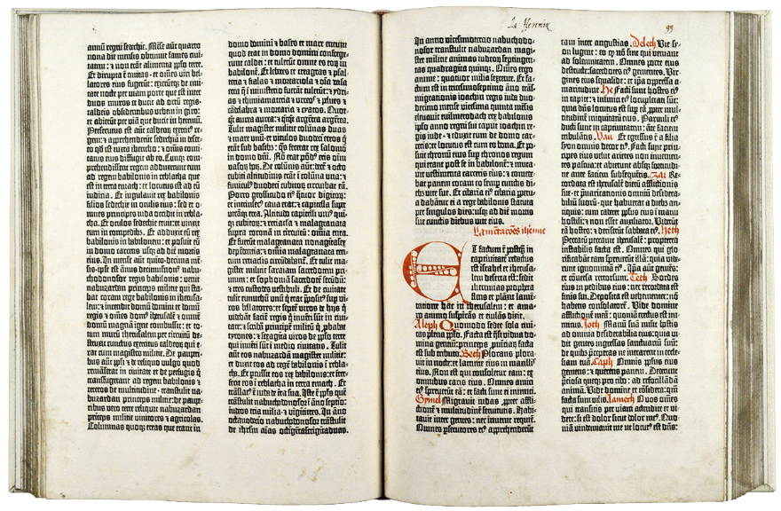
What Does the Bible Say?
In early Bibles there were no chapters and verses
There is no authoritative basis for the divisions we now use in the Bible. The chapter and verse divisions were added to the Bible for the sake of convenience. A man named Stephen Langton divided the Bible into chapters in the year A.D. 1227.
Notes:
Chapters and verses were not added until 1227 with no particular authoritative basis by The Archbishop of Canterbury, Stephen Langton simply for the convenience of finding certain passages with ease.

Slide 35
What Does the Bible Say?
In Exodus 20:2-17 there are:
16 verses
5 statements
1 Instruction
1 explanation
12 commandments
So How do we get ten commandments?
Notes:
In Exodus 20:2-17 and in Deuteronomy 5:6-21 there are 16 verses comprised of the following.
5 statements:
I am the LORD your God, who brought you out of the land of Egypt, out of the house of slavery.
For I, the LORD, your God, am a jealous God, inflicting punishment for their ancestors’ wickedness on the children of those who hate me, down to the third and fourth generation;
but showing love down to the thousandth generation of those who love me and keep my commandments.
six days you may labor and do all your work,
but the seventh day is a Sabbath of the LORD your God.
1 Instruction
You shall not do any work, either you, your son or your daughter, your male or female slave, your work animal, or the resident alien within your gates.
1 explanation
but on the seventh day he rested. That is why the LORD has blessed the Sabbath day and made it holy.
12 commandments
Have no God before me
Make no idols
Bow down to no idols
Do not use the Lord’s name in vain
Remember the Sabbath
Do no work on the Sabbath
Honor your father and mother
Do not kill
Do not commit adultery
Do not steal
Do not bear false witness
Do not covet a man’s wife
Do not covet a man’s possessions

Slide 36
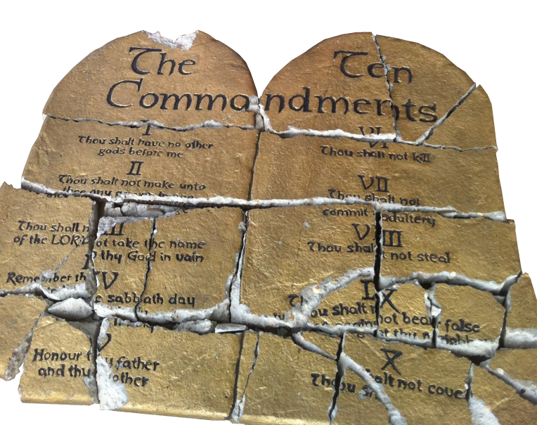
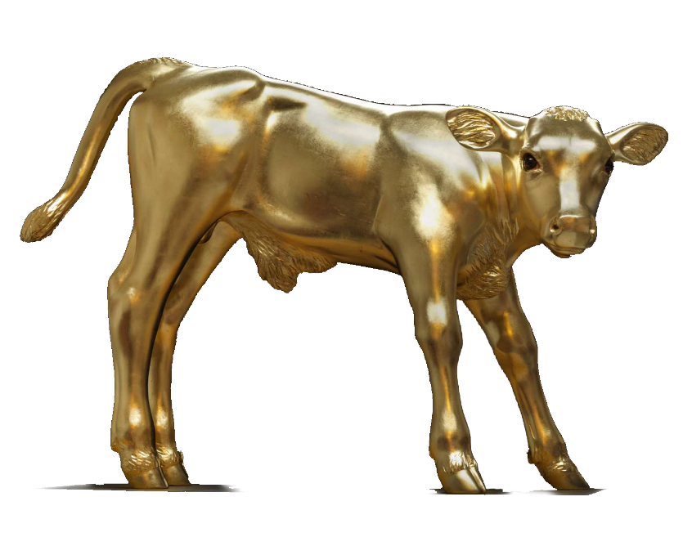
What Does the Bible Say?
Where in the Bible does is say there are 10 commandments?
Exodus 34:28 and Deuteronomy 4:13 and 10:2-4.
After Moses found the Golden Calf, he smashed the tablets but God had him make two more blank tablets and take them to the mountain where God inscribed upon them the ten words
In the original Hebrew the commandments are referred to as the ten words which are actually separate category headings for the 613 separate commandments handed down by Moses from God.
Notes:
Exodus 34:28
So Moses was there with the LORD for forty days and forty nights, without eating any food or drinking any water, and he wrote on the tablets the words of the covenant, the ten words.
Deuteronomy 4:13
He proclaimed to you his covenant, which he commanded you to keep: the ten words, which he wrote on two stone tablets.
Deuteronomy 10:4
The LORD then wrote on the tablets, as he had written before, the ten words that the LORD had spoken to you on the mountain from the midst of the fire on the day of the assembly; and the LORD gave them to me.
Jewish tradition holds that the first three commandments, having to do specifically with God, were written on one tablet, and the last seven, having to do specifically with fellow man was written on the second tablet.
In the original Hebrew the commandments are referred to as the ten words which are actually separate category headings for the 613 separate commandments handed down by Moses from God.

Slide 37
What Does the Bible Say?
So, Did Catholics change the 10 Commandments to satisfy their desire to worship Idols?
“The division and numbering of the Commandments have varied in the course of history. The present catechism follows the division of the Commandments established by St. Augustine, (354 – 430 AD) which has become traditional in the Catholic Church. It is also that of the Lutheran confessions. The Greek Fathers worked out a slightly different division, which is found in the Orthodox Churches and Reformed communities.”
CCC 2066
Notes:
The ten commandments have been in their present format in the Catholic Church since St. Augustine defined them around 400 AD

Slide 38
A Common Misunderstanding
In fact, it was not the Protestants who changed the divisions of the commandments but the early Greek Orthodox Church.
Only after the abbreviated forms of the ten commandments became popular did some Protestant denominations accept the Orthodox versions.

Slide 39
A Common Misunderstanding
So, did Catholics throw out the second commandment so they could justify idol worship?
Did Protestants modify the first commandment to justify their stance that Catholics are idolaters.
Not at all,
Notes:
A common misunderstanding between Catholics and Protestants is the order and content of the ten commandments, the chief issue being the practice of worshiping idols.
Protestants claim that the Catholic Church threw out the second commandment because it did not agree with their practice of worshiping idols.
Some Catholics claim that Protestants specifically reorganized the first commandment to prove scripturally that Catholics worship idols.
Both statements are completely false.
First, the Lutheran Church was the first church to protest Catholicism and split from the Catholic Church and while Luther eventually did throw out seven books of the Old Testament, and rearranged a bit of text to better suit his personal beliefs, he did not change the Ten Commandments and in fact, the Lutheran Church today holds to the same order and listing of the Commandments as the Catholic Church.

Slide 40
A Common Misunderstanding
With logic and reason we can demonstrate:
Catholics have used the same listing of the ten commandments since the beginning of the church.
Protestants did not modify the divisions and Lutherans still use the same version as Catholics.

Slide 41
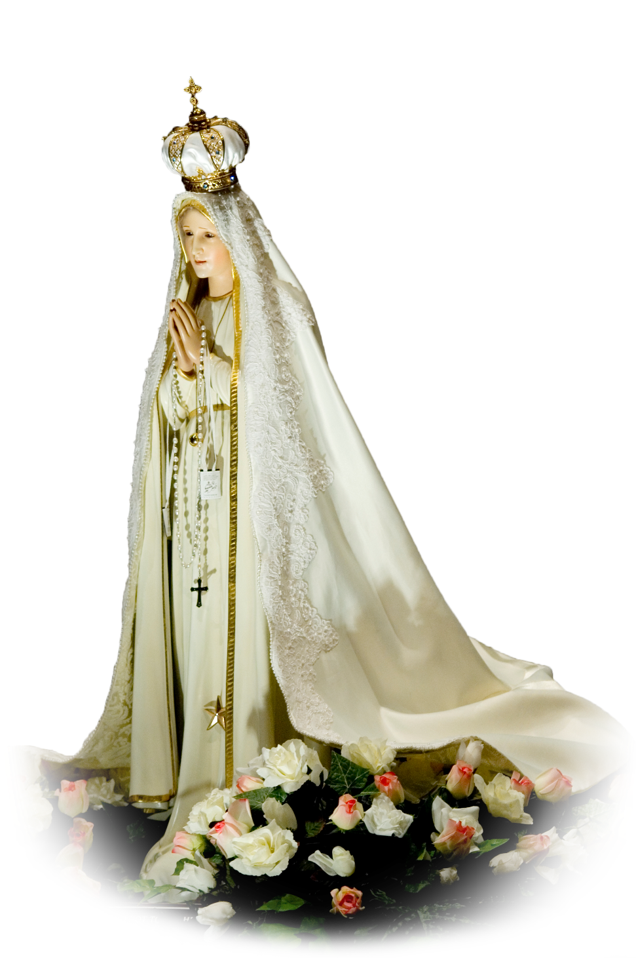
A Common Misunderstanding
So, what’s the problem?
Idolatry
But that’s another lesson.
Notes:
So having logically and with reason removed all mystery about the scriptural basis for the ten commandments, and having shown that there is no difference in the scriptures recording the commandments, what is the problem?
In a word, Idolatry.
We know that Catholics do not practice idolatry, but how do we explain this in a way non Catholics will understand?
Well, perhaps that’s the next lesson…

Slide 42
Apologetics… Defending the Faith
Scripture in Support of Our Catholic Beliefs

